Slide 1
BAN 502 – Module 3 Model Validation
Dr. Stephen E. Hill

Slide 2
Assessing a Model
True Test of a Model:
How the model performs on data that it has not “seen”
Options
Wait for new data
Simulate existence of unseen data… (Our choice via splitting and similar techniques)

Slide 3
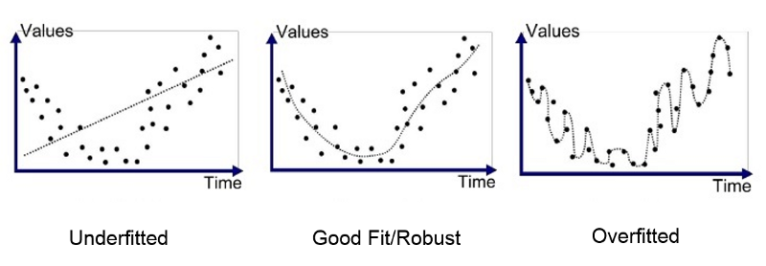
Assessing a Model
Overfitting
Model fits data too well!
Performs poorly on new data
Source: https://medium.com/greyatom/what-is-underfitting-and-overfitting-in-machine-learning-and-how-to-deal-with-it-6803a989c76

Slide 4
Assessing a Model
Splitting
Randomly* split data into sets
Avoids overfitting
Source: https://medium.com/greyatom/what-is-underfitting-and-overfitting-in-machine-learning-and-how-to-deal-with-it-6803a989c76

Slide 5
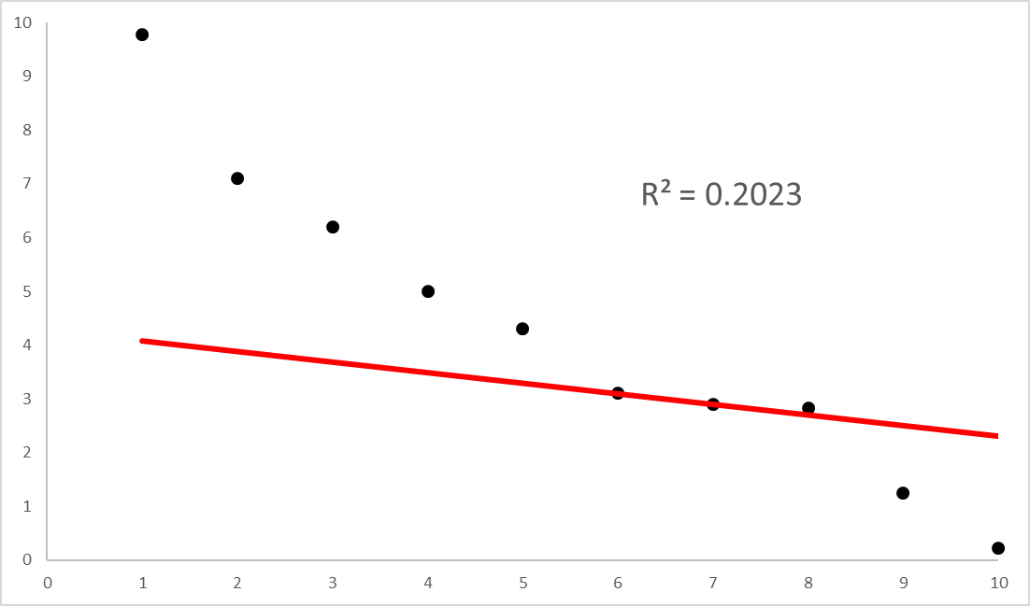
Assessing a Model
Source: https://medium.com/greyatom/what-is-underfitting-and-overfitting-in-machine-learning-and-how-to-deal-with-it-6803a989c76

Slide 6
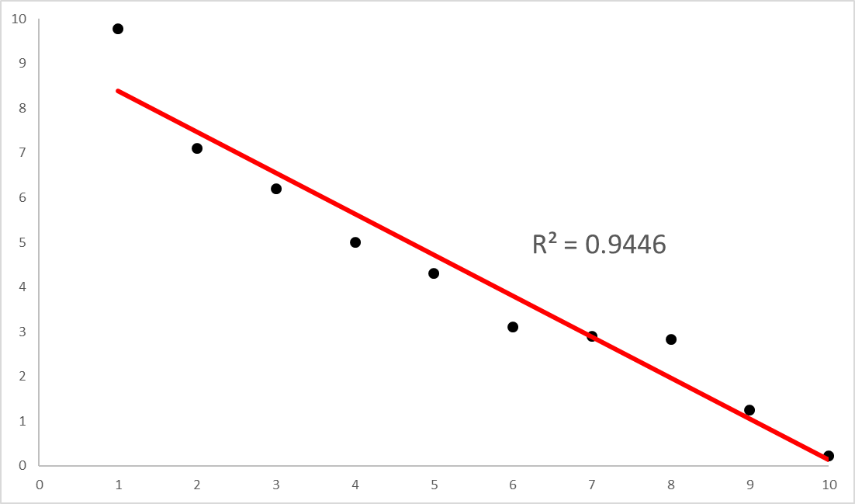
Assessing a Model
Source: https://medium.com/greyatom/what-is-underfitting-and-overfitting-in-machine-learning-and-how-to-deal-with-it-6803a989c76

Slide 7
Assessing a Model
Source: https://medium.com/greyatom/what-is-underfitting-and-overfitting-in-machine-learning-and-how-to-deal-with-it-6803a989c76

Slide 8
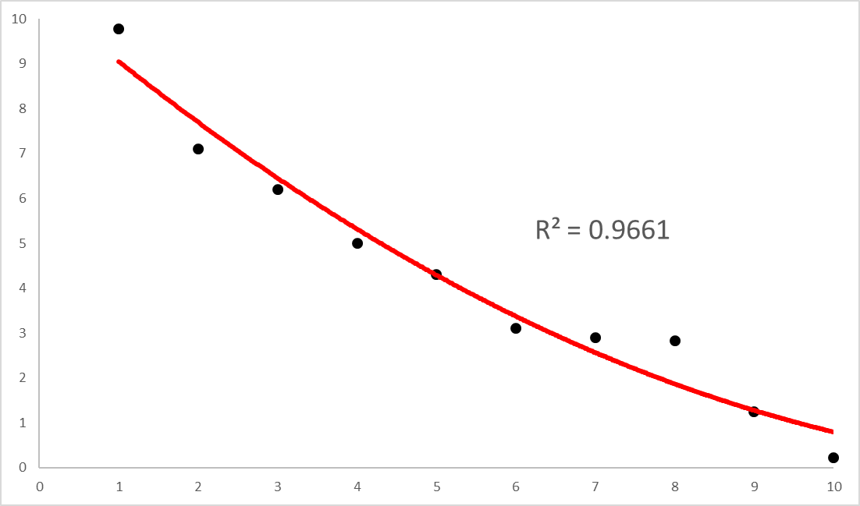
Assessing a Model
Source: https://medium.com/greyatom/what-is-underfitting-and-overfitting-in-machine-learning-and-how-to-deal-with-it-6803a989c76

Slide 9
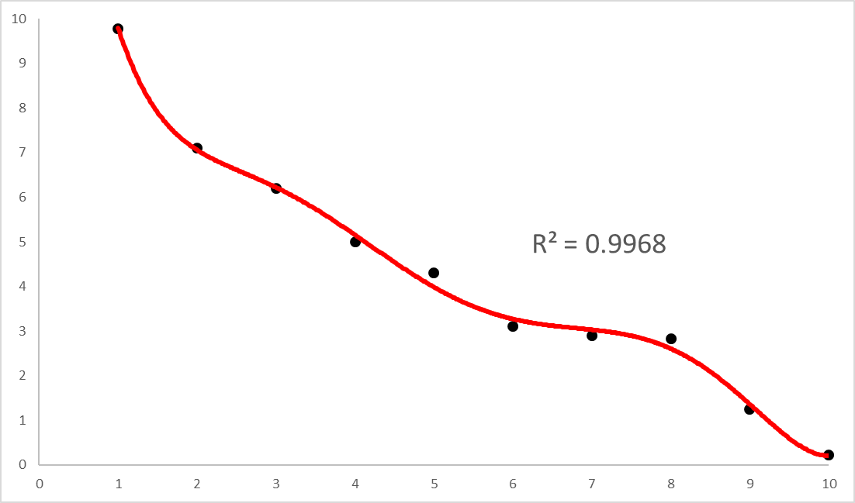
Assessing a Model
Source: https://medium.com/greyatom/what-is-underfitting-and-overfitting-in-machine-learning-and-how-to-deal-with-it-6803a989c76

Slide 10
Train/Test Split
Simplest Splitting Approach
Training → 70-80%
Testing → 20-30%
Can balance class distributions
Build and evaluation models on Training Set
Easy, but may not reduce overfitting enough
Training
Testing

Slide 11
k-Fold Cross-Validation
Split data into k “folds” (partitions)
Evaluate model k times (holding out 1 fold)
Typical k = 3, 5, or 10
1
2
…
5

Slide 12
Leave-One-Out Cross-Validation
Split data into “folds” with each fold containing 1 observation (n total folds where n is number of observations)
Evaluate model n times
Appropriate for small datasets

Slide 13
Which Splitting Approach to Use?
“Small” Dataset
Leave-One-Out or Leave-p-Out
“Large” Dataset
k-fold
“Very Large” Dataset
Train/Test with k-fold on Training Set

